Slide 1

E-Commerce Text Classification Analysis
Group 6

Slide 2

Task Description
Objective: Develop a machine learning model that can accurately classify e-commerce text into categories such as Electronics, Clothing & Accessories, Books, and Household.
Problem Statement: With the vast array of products online, manual classification is not feasible. Automating this process increases efficiency and user experience.
Contribution: Our group focused on creating an end-to-end machine learning pipeline to address this classification task, from data preprocessing to model evaluation.

Slide 3
Methodology
Preprocessing:
  Tokenization, lemmatization, and removal of stop words using Spacy.
  Transformation of text data into a numerical format using TfidfVectorizer.
Modeling:
  Selection and training of models: XGBoost and RandomForest classifiers.
  Hyperparameter tuning with GridSearchCV for optimal model performance.
State of the Art and Literature Analysis:
  Reviewed current methodologies and tools in text classification and natural language processing, justifying our choice of TfidfVectorizer for text representation and ensemble methods for classification.

Slide 4
Our notebook:
Exploratory Data Analysis and Preprocessing
In this notebook, e-commerce text data is meticulously explored and prepared for machine learning.
Data cleaning involves addressing missing values and ensuring a consistent column naming convention.
The dataset's characteristics, such as its shape, presence of null values, and unique values in each column, are examined for a better understanding.
Visualization techniques, including the use of 'missingno,' are applied to visualize missing data patterns.
The distribution of labels is visualized through countplots and pie charts, providing insights into the dataset's class balance.

Slide 5
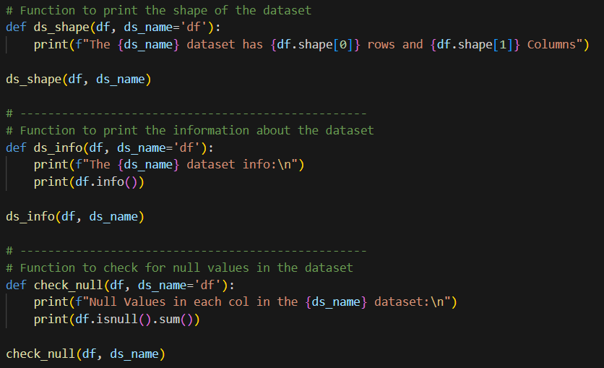
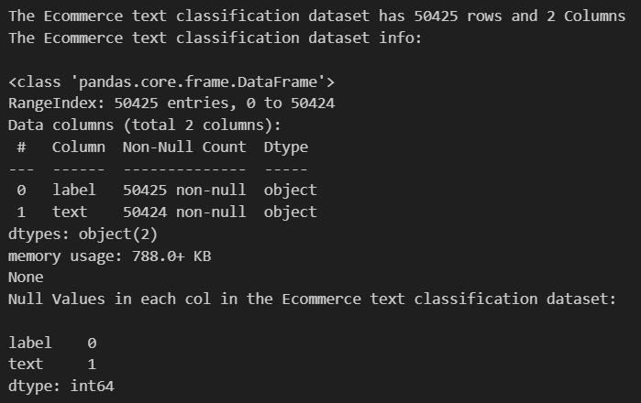
Data set shape, information & null values

Slide 6
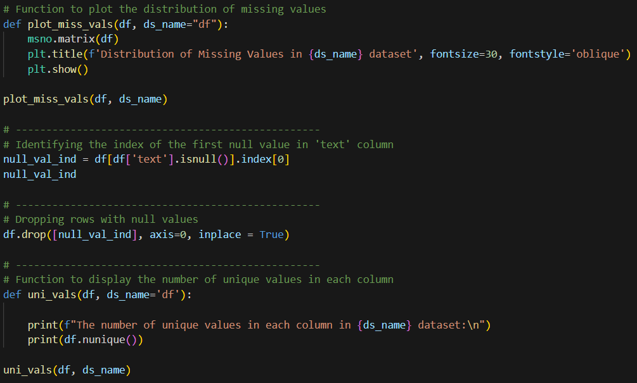
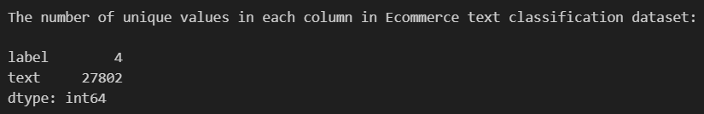
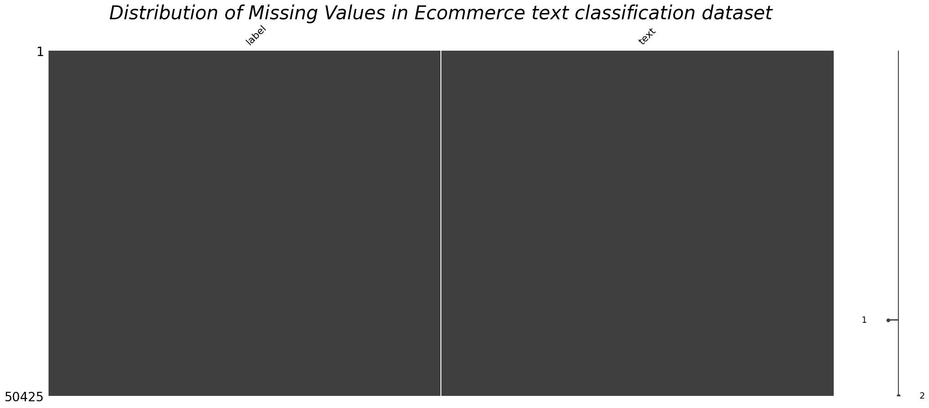
Unique values & Distribution of missing values

Slide 7
Our notebook:
Exploratory Data Analysis and Preprocessing
Word clouds are generated to visually represent the most common words in the text data.
The distribution of letter and word counts in each text is analyzed to gain a deeper understanding of the text's structure.
An exploration of average word lengths further enriches the data understanding.
Tokenization, lemmatization, and text normalization are employed to preprocess the textual data.

Slide 8
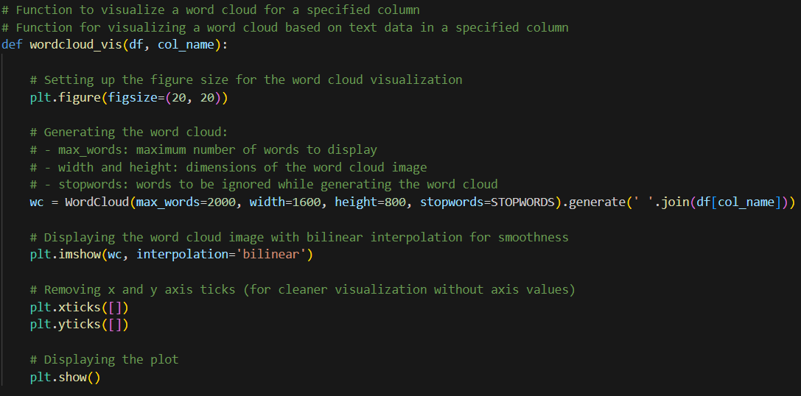
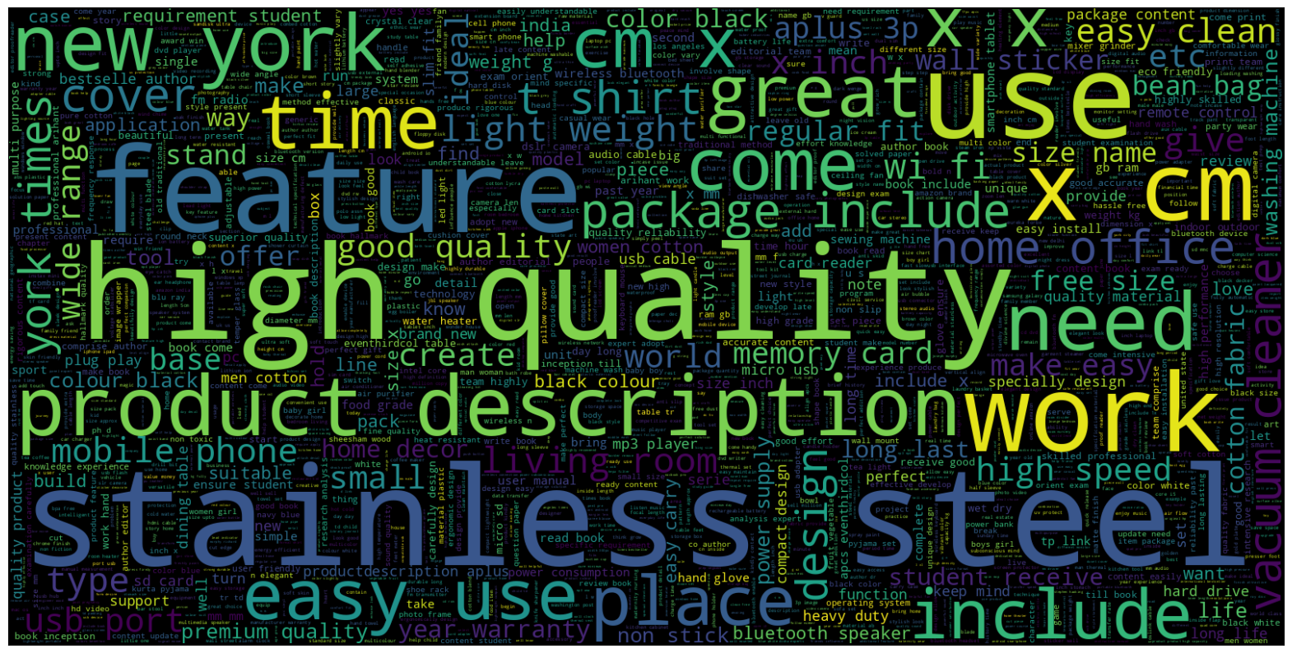
Results
Word Cloud

Slide 9
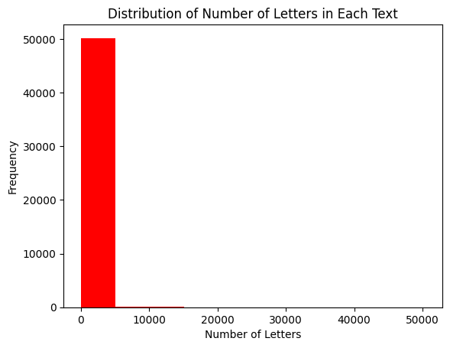
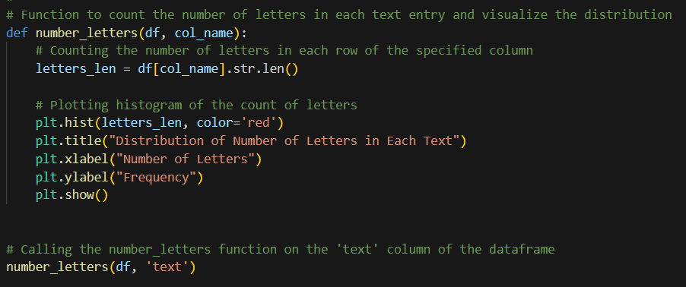
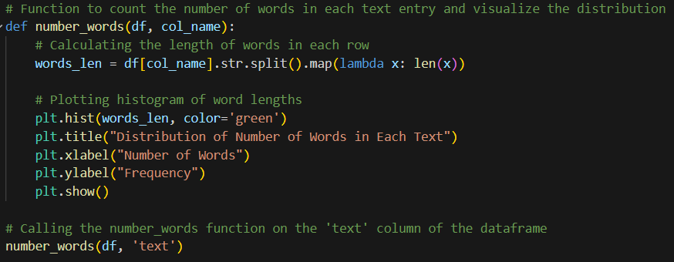
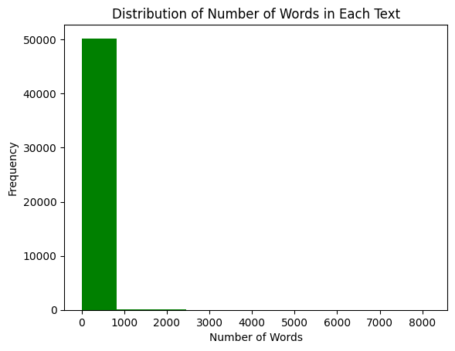
Distribution of Number of Letters & Words in each text

Slide 10
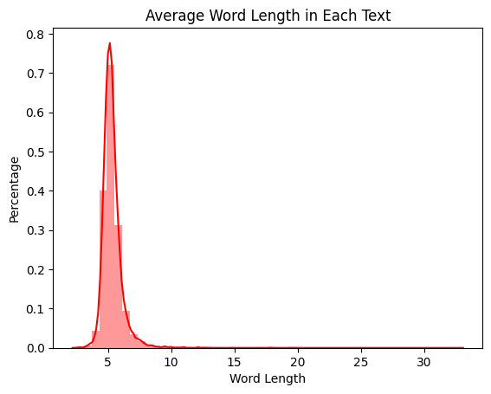
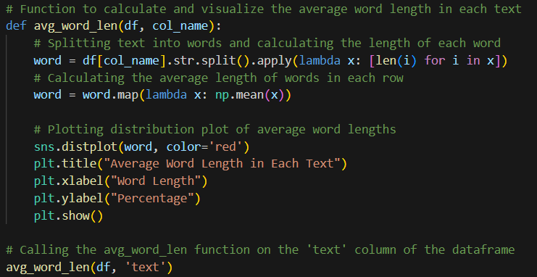
Average Word Length in each text

Slide 11
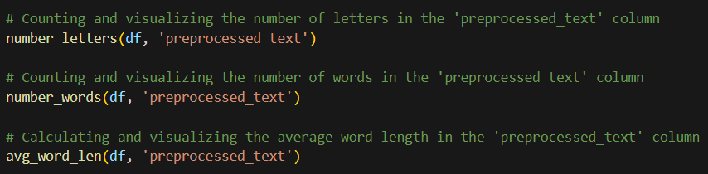
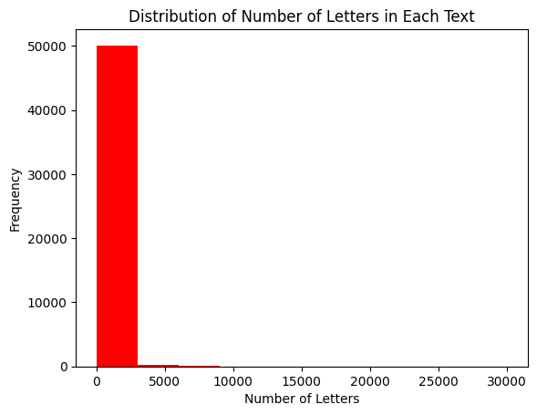
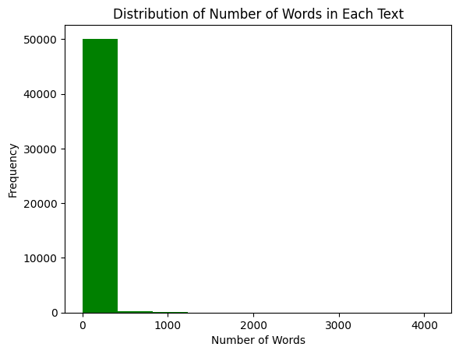
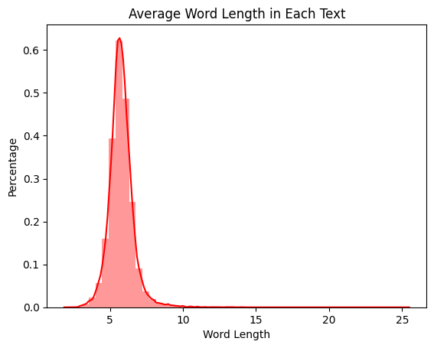
Visualization in „preprocessed_text“ column

Slide 12
Our notebook:
Feature Engineering and Model Building
Feature extraction is accomplished through TF-IDF vectorization, converting text into numerical features suitable for machine learning models.
Label encoding is applied to convert target labels into numeric form for modeling.
The notebook proceeds to train machine learning models, including XGBoost and Random Forest classifiers, on the processed data.
Model evaluation metrics such as accuracy, F1-score, confusion matrices, and classification reports are used to assess model performance.
The Random Forest model is saved along with the TF-IDF vectorizer and label mapping for future deployment.

Slide 13
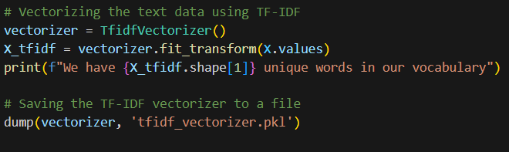
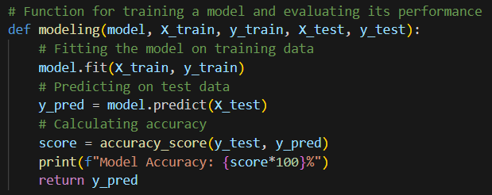
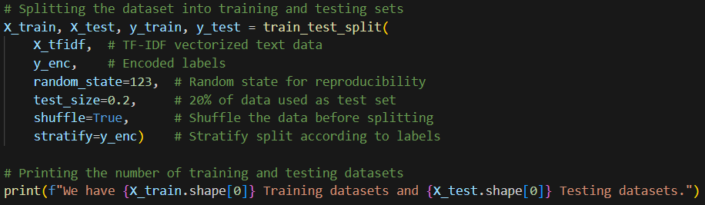
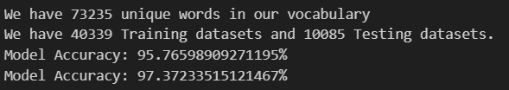
Vectorizing text data, training/testing sets & Performance Evaluation

Slide 14
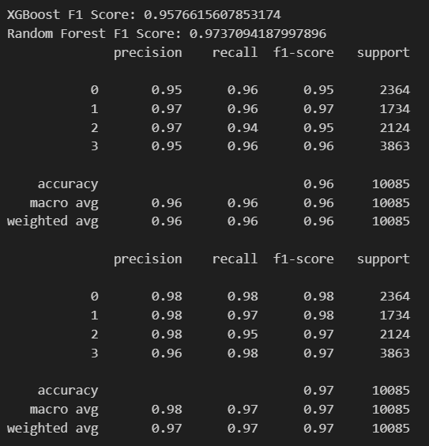
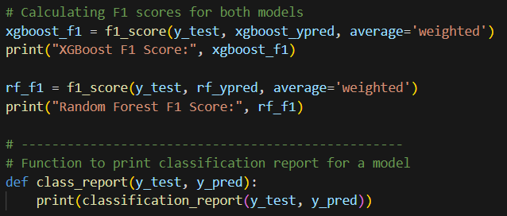
F1 Scores & Classification report

Slide 15
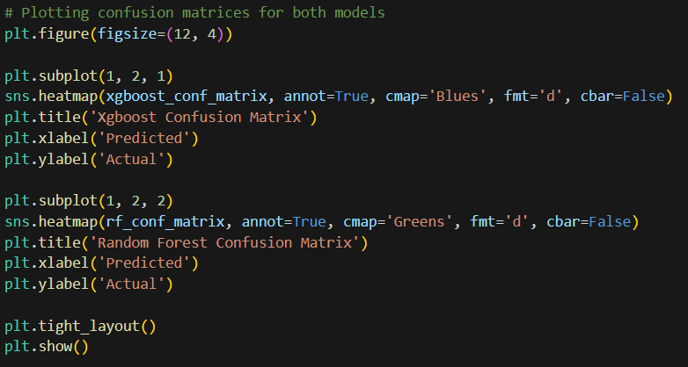
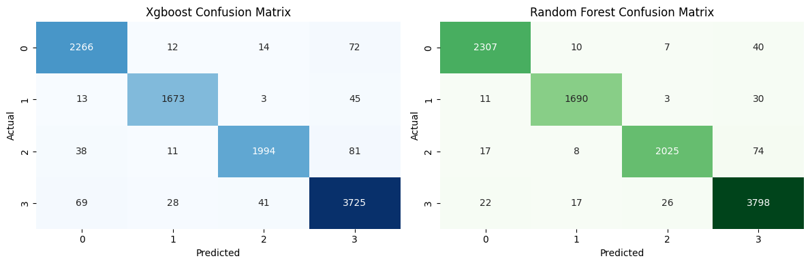
Confusion Matrix:
XGBoost vs. Random Forest

Slide 16
Experimental Results
Model Evaluation Metrics:
  The RandomForest model showed a higher F1 score, indicating better performance on our dataset.
Model Selection:
  Based on the evaluation metrics, we selected RandomForest as our final model.

Slide 17
Our notebook:
Prediction and Model Explanation
The notebook demonstrates how to predict labels for specific text data using the trained model.
Going beyond prediction, the notebook introduces LIME (Local Interpretable Model-agnostic Explanations) to provide model explanations.
LIME offers insights into how the model reaches its predictions, fostering transparency and user trust.

Slide 18
Our notebook:
Streamlit Deployment, Data Preprocessing and Tokenization
This script deploys an E-commerce Text Classifier using the Streamlit framework, making it accessible to a wide range of users.
The script begins by loading the trained machine learning model, TF-IDF vectorizer, and label mapping dictionary.
Text data entered by users undergoes preprocessing, including tokenization, stop word removal, punctuation handling, and lemmatization.
These preprocessing steps ensure that user-provided text aligns with the format used during model training.

Slide 19
Our notebook:
Feature Engineering & Machine Learning Model
Preprocessed text is transformed into numerical features using the TF-IDF vectorizer, preparing it for classification.
The script incorporates a prediction function, predict_label(text), which takes user input and predicts the most suitable label.
The predicted label is displayed within the Streamlit app for user convenience.

Slide 20
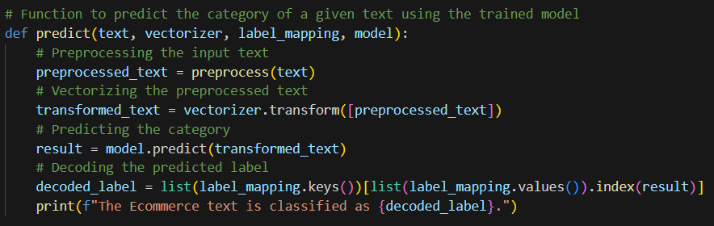
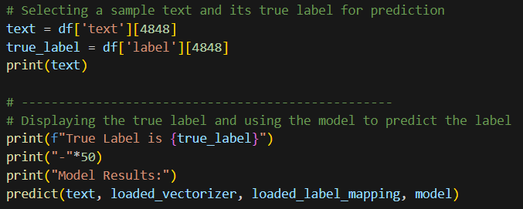
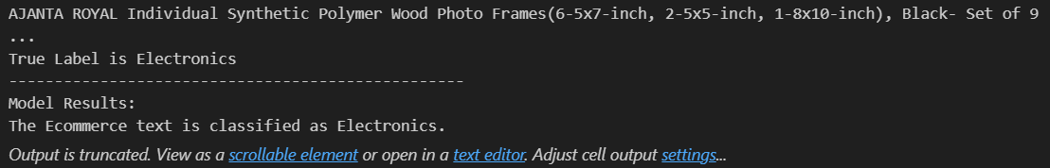
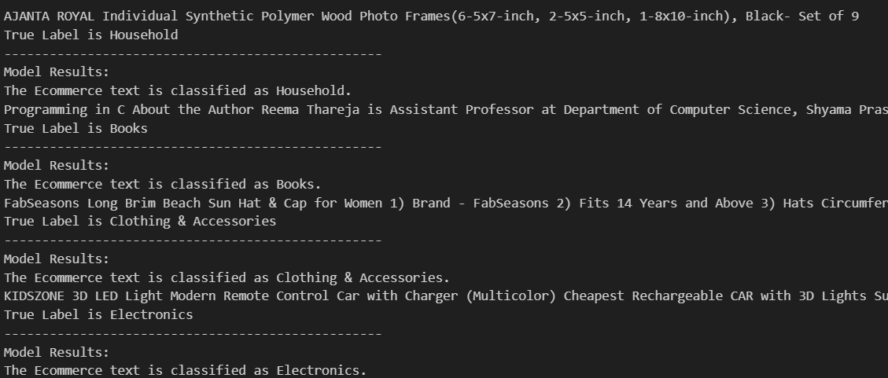
Model Results
Here you can see the predictions from our working model. As you can see, the true label matches with the predicted label, which means our model can correctly identify the category .

Slide 21
Our notebook:
Model Explanation with LIME
Going beyond prediction, the script utilizes LIME (Local Interpretable Model-agnostic Explanations) to offer model explanations.
LIME provides insights into how the model arrived at its predictions, enhancing user understanding and trust in the classification process.

Slide 22
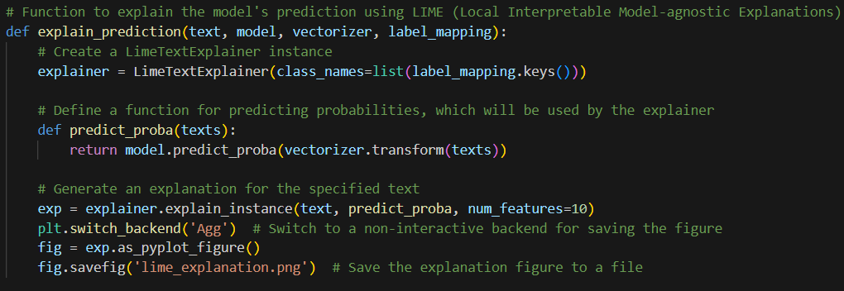
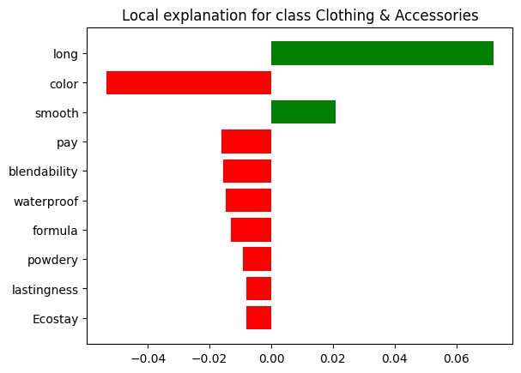
Adding LIME
Words like “long“ and “smooth” positively influence the classification towards "Clothing & Accessories", which makes sense as these words are commonly associated with clothing items.
Words like “color" , “pay”, etc. seem to be negatively influencing the prediction. This could be due to several reasons, such as these words also being common in other classes leading to ambiguity, or it might be an artifact of the particular dataset and model.

Slide 23
Our notebook:
User Interface with Streamlit
The script creates a user-friendly Streamlit application titled "E-commerce Text Classifier," making it easy for users to interact with the model.
Users can conveniently input text data via a text area provided by the Streamlit interface.
The "Classify" button triggers the prediction function and LIME explanation, offering an intuitive user experience.
The predicted label and LIME explanations are displayed within the Streamlit app for immediate user feedback.

Slide 24
Our notebook:
Deployment Benefits & Overall Impact
By streamlining text classification for users, the notebook enhances accessibility.
Users can conveniently classify text without requiring technical expertise.
Furthermore, model explanations using LIME enhance the overall transparency of the classification process.
The notebook's comprehensive approach bridges the gap between machine learning models and end-users.
Practical applications of natural language processing in e-commerce are promoted, thanks to detailed data processing and model building techniques.
Users gain insights into the classification process through LIME explanations, fostering trust and understanding.

Slide 25
Our notebook:
Deployment Benefits & Overall Impact
The deployment script simplifies text classification, making it accessible to users without technical expertise.
It bridges the gap between machine learning models and end-users, promoting practical applications of natural language processing in e-commerce.
Model explanations using LIME enhance transparency and user trust in the classification process.
The Streamlit deployment script enhances accessibility and usability, making text classification accessible to a broader audience.
By providing insights into the classification process through LIME explanations, it fosters trust and understanding among users.

Slide 26
Conclusion
The RandomForest model outperformed the XGBoost model in terms of the F1 score, making it our model of choice.
The model's high accuracy suggests it can effectively categorize new e-commerce texts, streamlining the product listing process.

Slide 27
THANK YOU!

